Slide 1


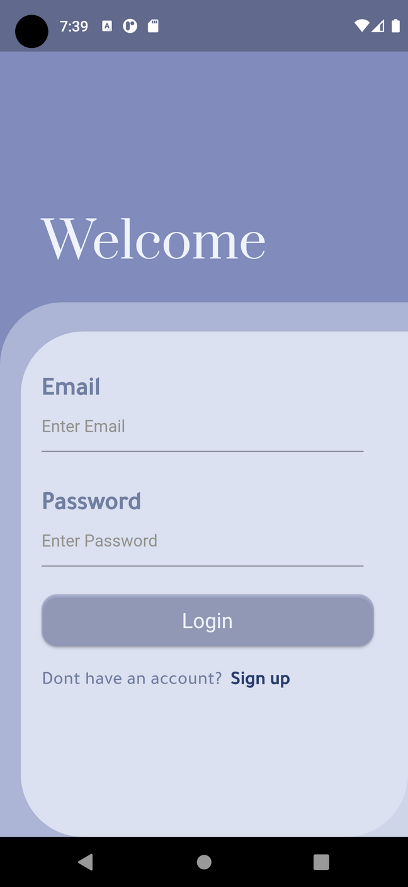
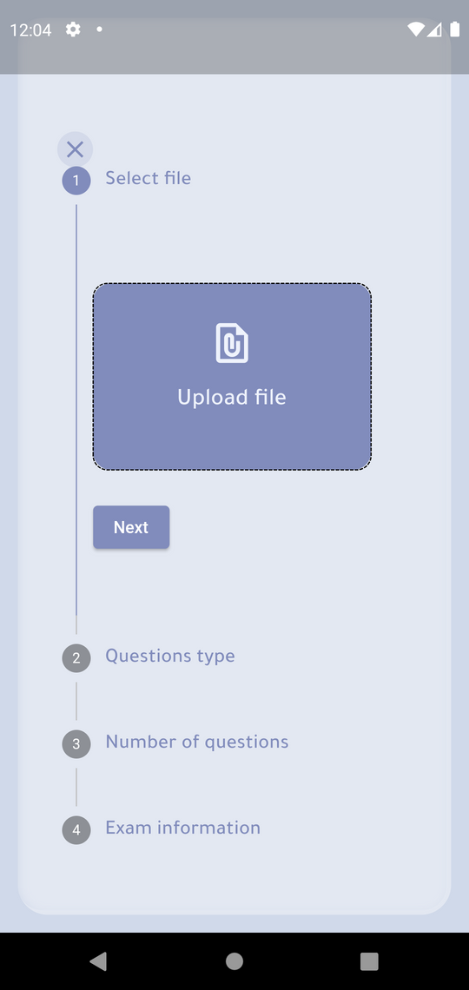
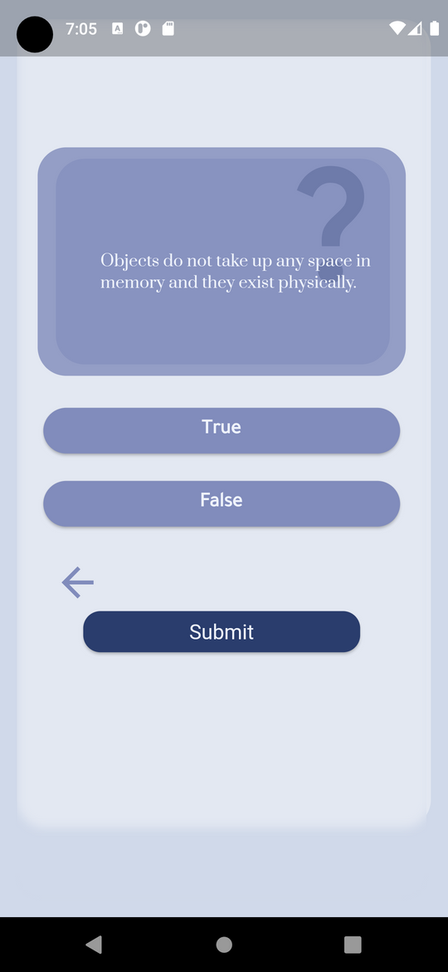
Aktabarni

Slide 2

TEAM MEMBERS
Lama Aldhafeeri
Team Leader
Mohammed Alawashiz
Mohammed Alshehri
Abrar Alotaibi

Slide 3
PROBLEM!!
NEXT

Slide 5
FEATURES
- Create exams.
- Private or public.
- Calendar!
NEXT

Slide 6

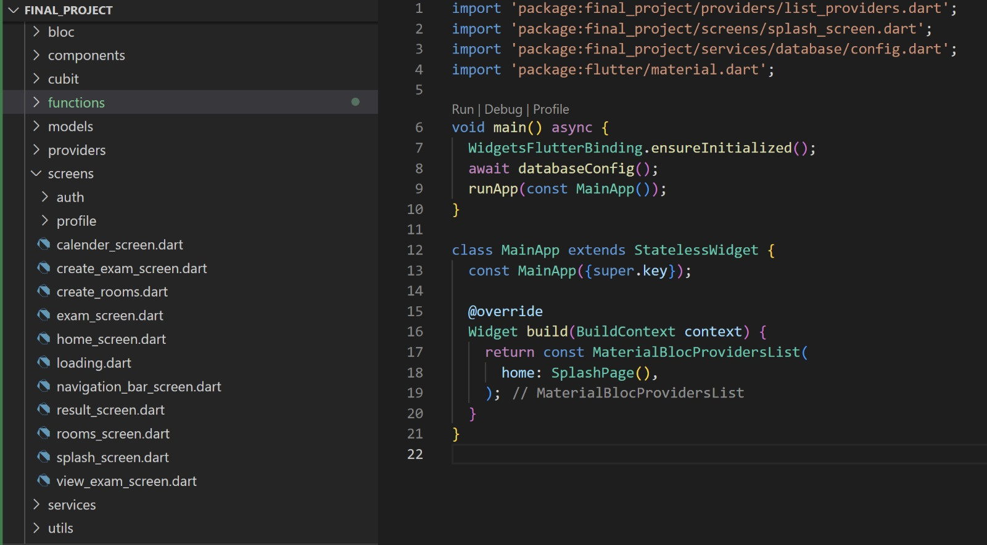

Slide 7


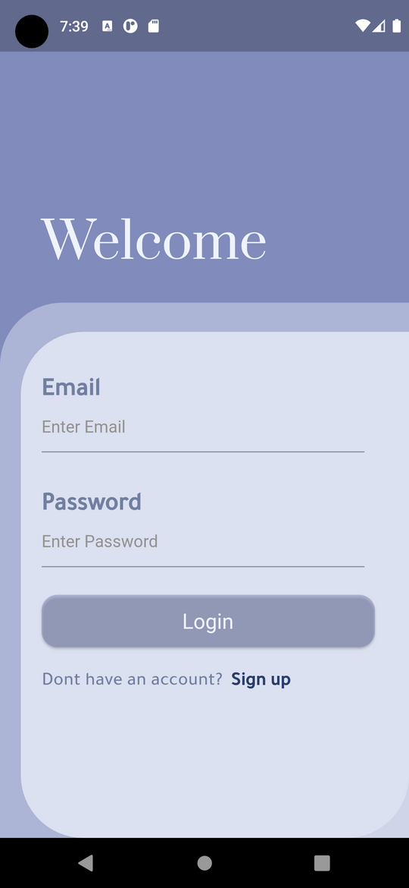
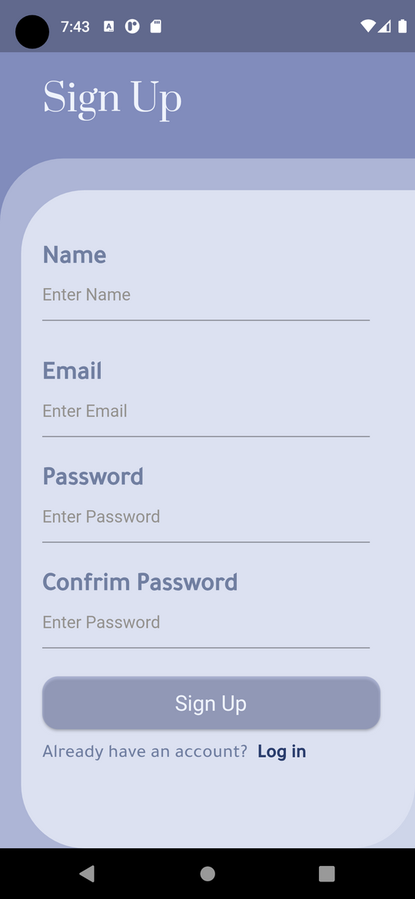
Auth

Slide 8
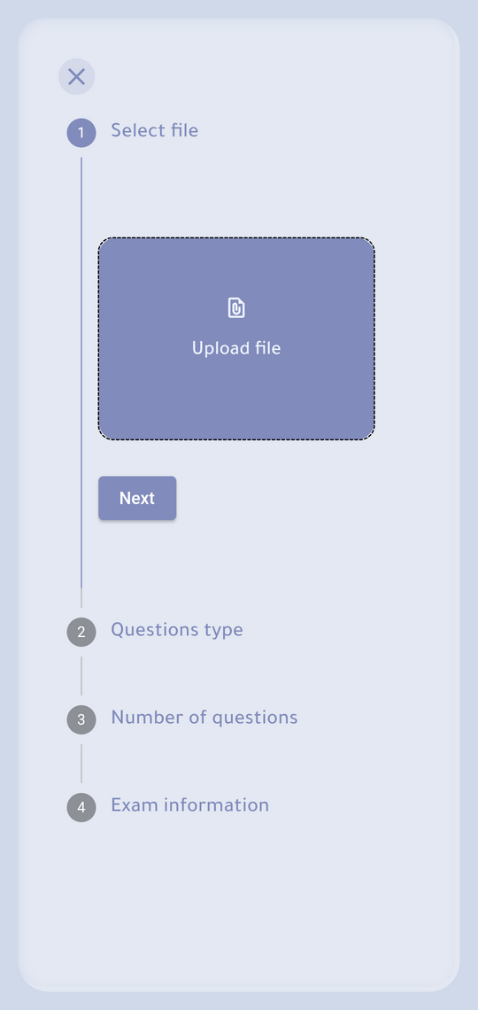
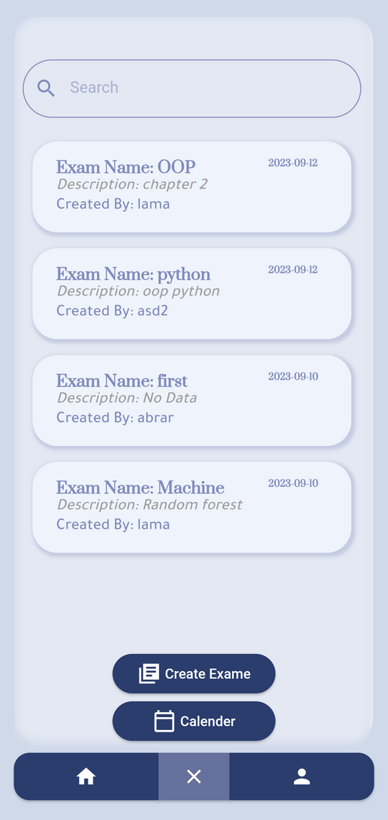
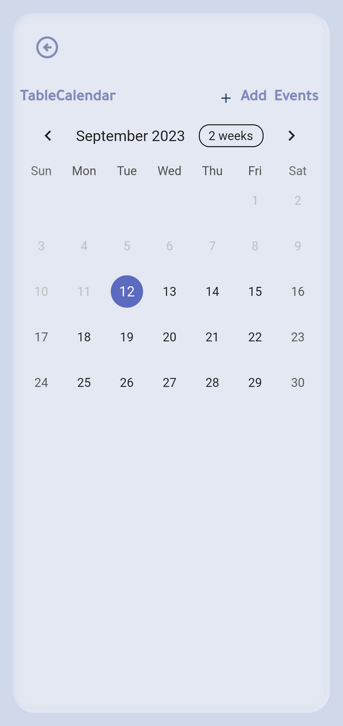
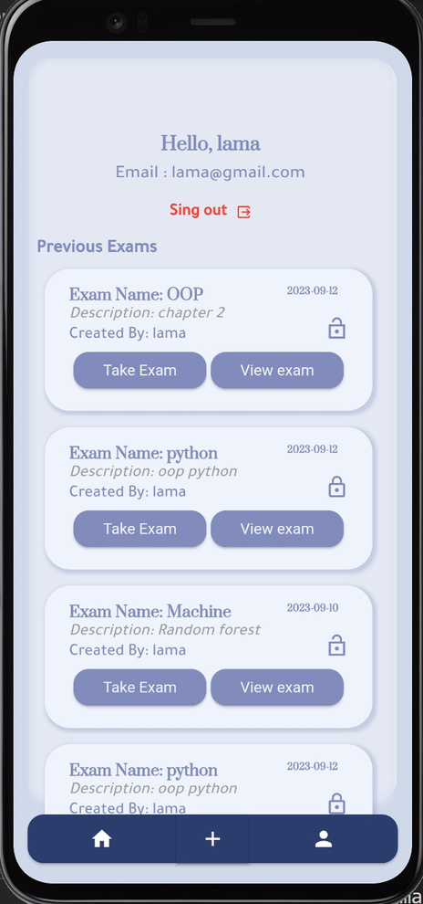
Main

Slide 9
Demo

Slide 10





SOFTWARE

Slide 11
Thank You

